Slide 1
Python Robot Arm
Steve Harris

Slide 2
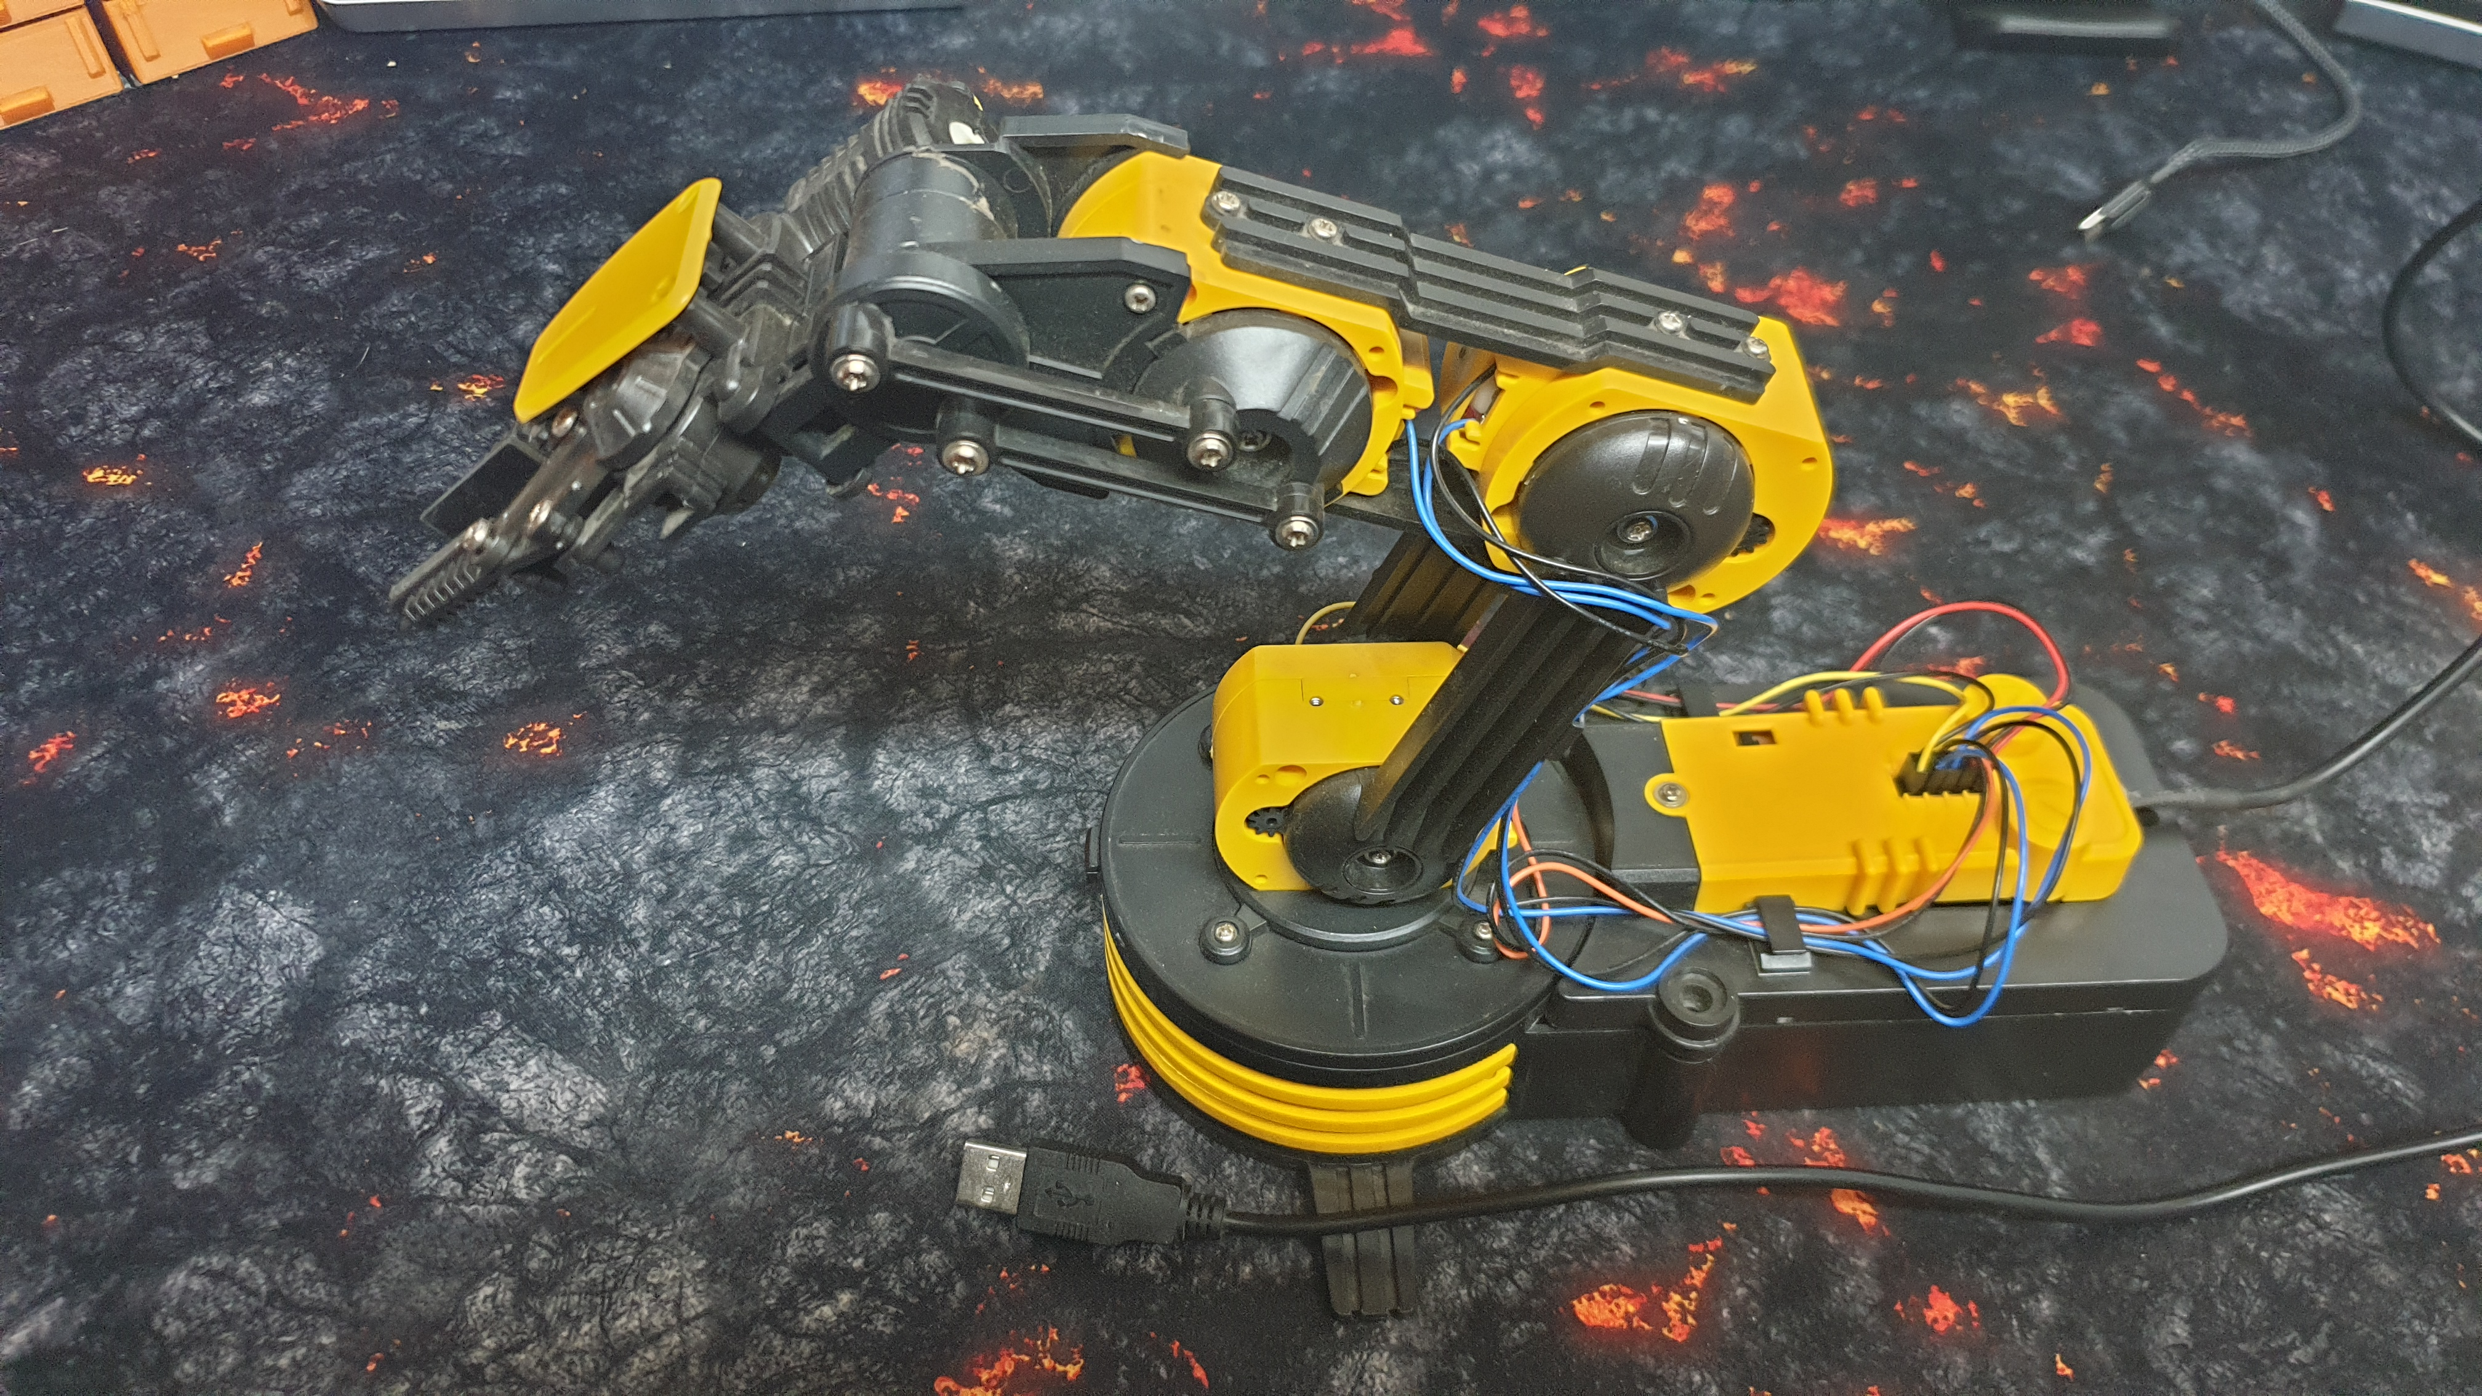
Steve Harris

Slide 3
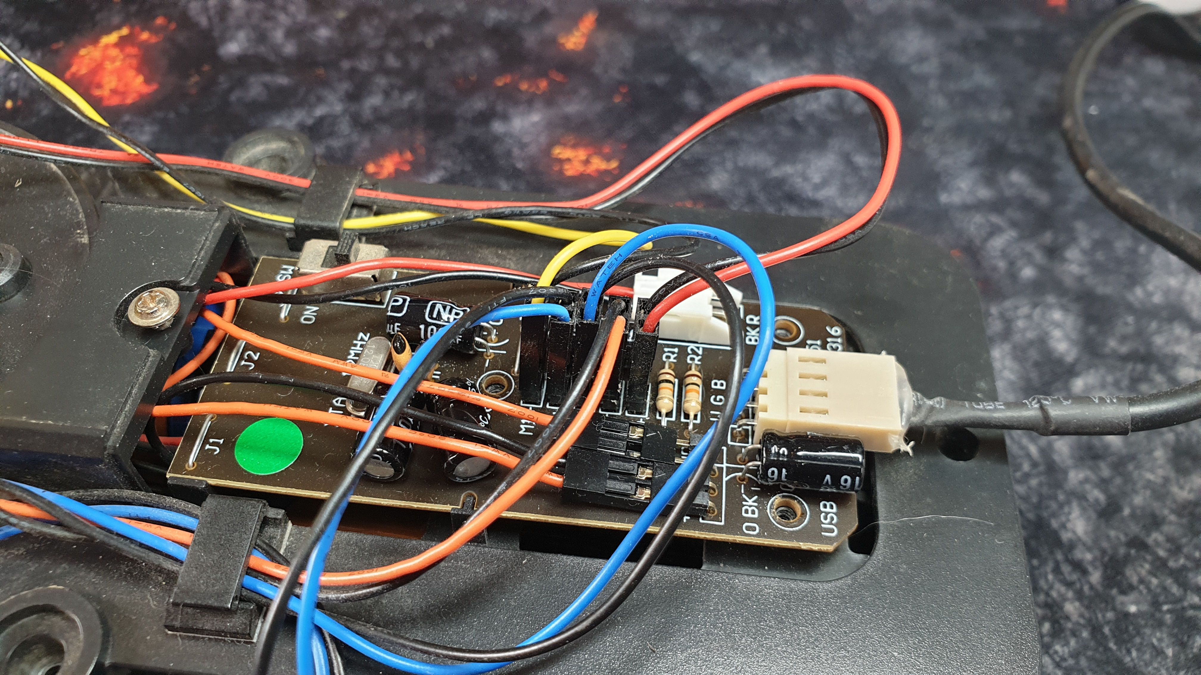
Steve Harris

Slide 4
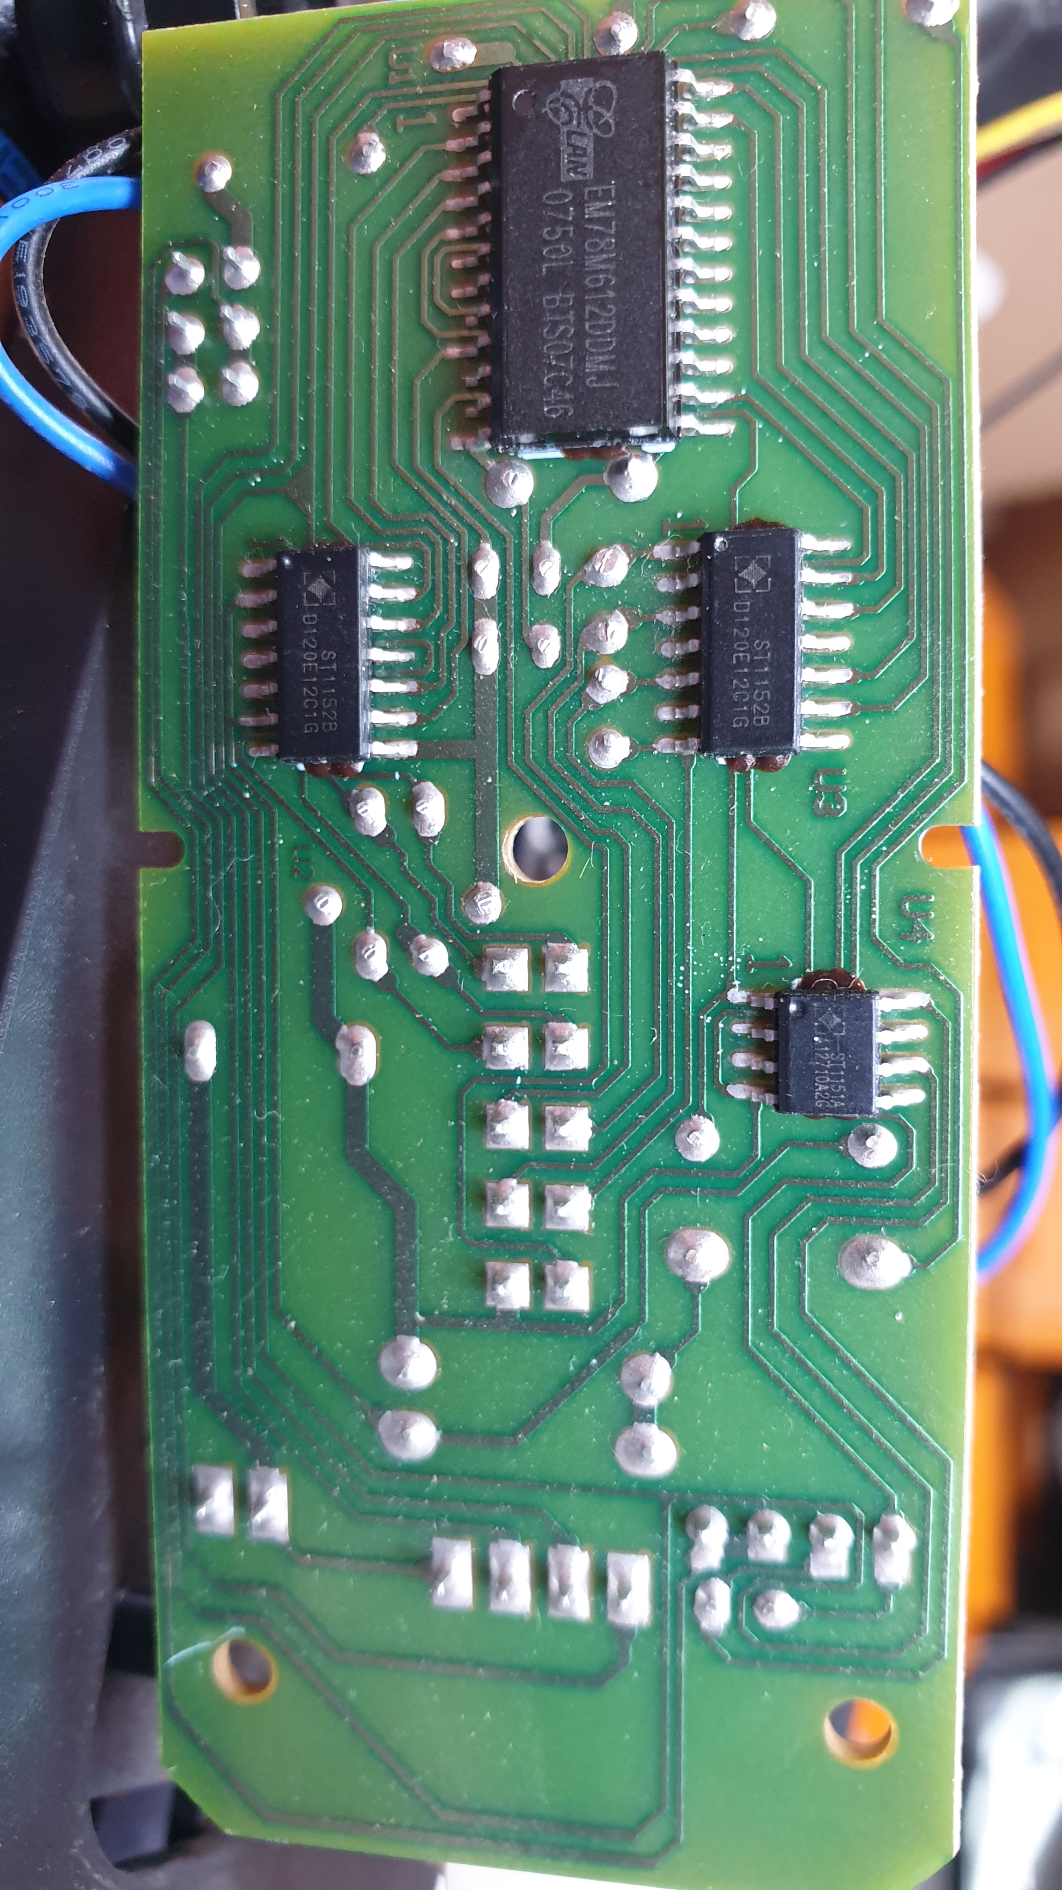
USB Controller
Low Voltage Bi-directional Motor Driver
Each Chip can control 2 stepper motors
Low Voltage Bi-directional Motor Driver
Controls 1 stepper motor
Supplies Voltage for LED Light
Steve Harris
Notes:
I had no idea if this arm could be controlled via Python
STEP: Look up ID number on chip on internet and find the documentation for each chip
USB Controller – for low speed USB devices such as Mouse, 112 bytes of SRAM, 4 bytes of EPROM
3x Low Voltage ST Chips = designed for stepper motor devices, cameras, printers, also used in toys.
ST1152B x2, - control motors ?
ST1151A x1 (small chip) low voltage for LED light ?
Those docs explained the binary patterns which each chip accepts and which pins on each chip are sent a voltage according to the binary code the chip receives
I worked out the codes and felt very smug with myself !!!
After doing all this I came across a blog post which explained it all !!!
SEE NEXT SLIDE

Slide 5
Binary
2 x 2 x 2 x 2 = 16
2⁷
2⁶
2⁵
2⁴
2³
2²
2¹
2⁰
128 | 64 | 32 | 16 | 8 | 4 | 2 | 1
byte
0 | 1 | 0 | 1 | 1 | 0 | 1 | 0
bit 7
bit 6
bit 5
bit 4
bit 3
bit 2
bit 1
bit 0
 | 64 |  | 16 | 8 |  | 2
64+16+8+2 = 90

Slide 6
3 Byte Instruction Set
Byte 0
Byte 1
Byte 2
128 | 64 | 32 | 16 | 8 | 4 | 2 | 1
128 | 64 | 32 | 16 | 8 | 4 | 2 | 1
128 | 64 | 32 | 16 | 8 | 4 | 2 | 1
0 | 0 | 0 | 0 | 0 | 0 | 0 | 0
0 | 0 | 0 | 0 | 0 | 0 | 0 | 0
0 | 0 | 0 | 0 | 0 | 0 | 0 | 0
shoulder | elbow | wrist | grip
 |  |  | base
 |  |  |  | 
 |  |  |  |  |  | 0 | 0
light off
 |  |  |  |  |  | 0 | 0
do not move
do not move
 |  |  |  |  |  |  | 0
 |  |  |  |  |  | 0 | 1
light on
 |  |  |  |  |  | 0 | 1
close
rotate clockwise
 |  |  |  |  |  |  | 1
 |  |  |  |  |  | 1 | 0
 |  |  |  |  |  | 1 | 0
rotate anti-clockwise
open
 |  |  |  | 0 | 0
do not move
 |  |  |  | 0 | 1
move up
Byte 0
Byte 1
Byte 2
 |  |  |  | 1 | 0
move down
 |  | 0 | 0
do not move
clockwise = [0, 1, 0] # rot base clockwise
anti_clockwise = [0, 2, 0] # rot base a-clockwise
shoulder_up = [64, 0, 0] # shoulder up
shoulder_down = [128, 0, 0] # shoulder down
light_off = [0, 0, 0] # light off
light_on = [0, 0, 1] # light On
 |  | 0 | 1
move up
 |  | 1 | 0
move down
0 | 0
do not move
0 | 1
move up
1 | 0
move down
Steve Harris
Notes:
In the python code, we send the decimal representation of the binary values of the motors we want to move
Limitation of chips that they can only interpret one byte of the three in each command and only one bit in that byte

